Slide 1

Topic: Floyd-Warshall Algorithm
Welcome to Algorithm Presentation

Slide 2
What is Floyd Warshall Algorithm?
The Floyd Warshall algorithm is a fundamental algorithm in computer science used for finding shortest paths between all pairs of vertices in a weighted graph.
Example of dynamic Programming
Useful for dense graphs
Can handle both positive and negative edge weights
No negative cycle

Slide 3
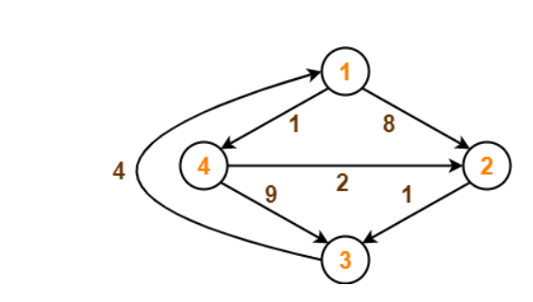
For example, we can solve Shortest path problem of the following weighted graph by using Floyd-Warshall Algorithm

Slide 4
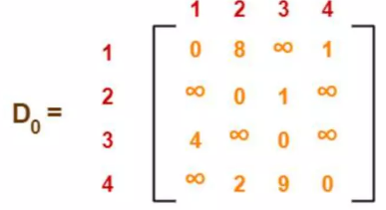
Step:01
We will create matrix according to vertices given in weighted graph
For example, for this example we will create D0, D1, D2, D3, D4
Create a matrix D0 of dimension where n is the number of vertices.
The row and the column are indexed as i and j respectively
For D0 we insert direct distance given in weighted graph

Slide 5
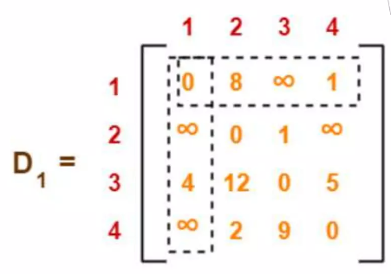
Step:02
We will leave 1st row and column as same as before
For D1, we will find shortest distance by going through '1' vertices
We will compare newfound value with previous matrix
We will fill that values which is shortest of two

Slide 6
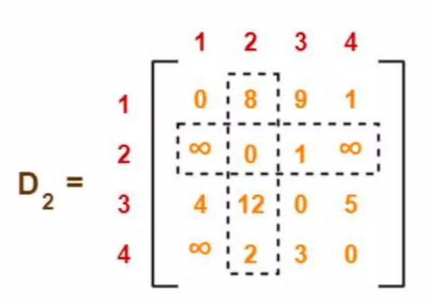
Step:03
We will leave 2nd row and column as same as before
For D2, we will find shortest distance by going through '2' vertices
We will compare newfound value with previous matrix
If we get minimum shortest path then we replace otherwise not

Slide 7
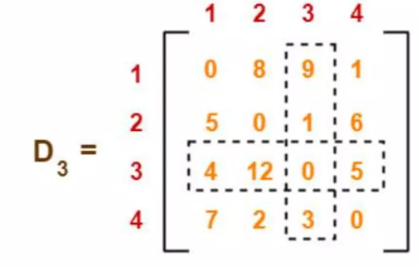
Step:04
We will leave 3rd row and column as same as before
For D3, we will find shortest distance by going through ‘3' vertices
We will compare newfound value with previous matrix

Slide 8
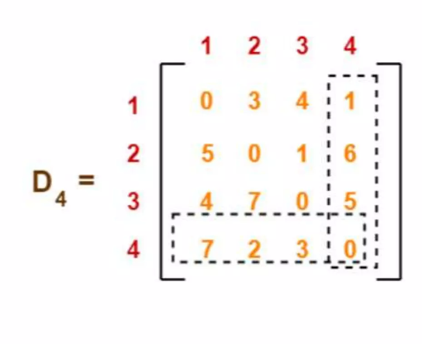
Step:05
We will leave 4th row and column as same as before
For D4, we will find shortest distance by going through ‘4' vertices
We will compare newfound value with previous matrix
We will fill that values which is shortest of two otherwise not

Slide 9
Applications of Floyd-Warshall Algorithm
Network Routing Protocol
Traffic Management Systems
Distance Vector Routing Protocols

Slide 10

Comparative Analysis: Floyd-Warshall Algorithm
Floyd-Warshall vs. Dijkstra’s:
Floyd-Warshall handles negative edge weights and finds shortest paths between all pairs of vertices, while Dijkstra's algorithm works for single-source shortest path.
Floyd-Warshall vs. Bellman-Ford:
Floyd-Warshall is more efficient for finding shortest paths between all pairs of vertices, whereas Bellman- Ford works well for graphs with negative cycles.

Slide 11
Advantages of floyd warshall algorithm
All-pairs shortest paths: Unlike Dijkstra's algorithm that finds the shortest path from a single source, Floyd-Warshall calculates the shortest distances between every pair of vertices in the graph. This is incredibly useful for route planning and network analysis.
Relatively easy to understand and implement: Compared to some other graph algorithms, Floyd-Warshall is considered conceptually straightforward. This makes it a good choice for beginners to learn about dynamic programming.
Efficient for dense graphs: With a time complexity of O(V^3), Floyd-Warshall can handle dense graphs (where most vertices are connected) efficiently.
Parallelizable: The algorithm can be broken down into independent subproblems, allowing it to be run on multiple processors for faster execution.

Slide 12
Disadvantages of floyd warshall algorithm
Slow for sparse graphs: For sparse graphs (where there are few connections between vertices), the O(V^3) complexity becomes a bottleneck. There are more efficient algorithms like Dijkstra's for sparse graphs.
Memory usage: The algorithm uses a distance matrix to store all pair-wise shortest distances. This can consume significant memory for large graphs.
Doesn't provide actual paths: While it calculates shortest distances, Floyd-Warshall doesn't explicitly tell you the exact sequence of vertices for the shortest path between two points. You might need additional modifications to find the actual paths.
Not suitable for dynamic graphs: If the edge weights in your graph change frequently, Floyd-Warshall becomes inefficient as it requires recalculating the entire matrix for each change.

Slide 13

Complexity Analysis 1.Time 2.Space

Slide 14

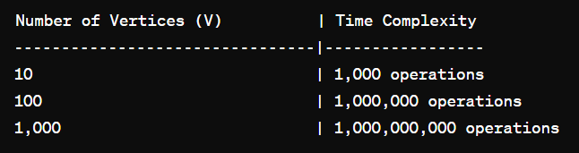
Time Complexity Analysis
Triple Nested Loops:
Outer Loop (k): Runs V times
Middle Loop (i): Runs V times
Inner Loop (j): Runs V times
Total Iterations:
𝑉×𝑉×𝑉=V³
Thus, the time complexity is O(V³).
Graphical Representation:

Slide 15
Best Case, Average Case, and Worst Case
Best Case
In the best case, if the initial input distance matrix already represents the shortest paths (i.e., no updates are needed), the algorithm still needs to iterate through all possible triples of vertices to confirm this.
Time Complexity: O(V³).
Average Case
On average, the graph may have a typical distribution of edge weights and distances. The algorithm will generally perform a mix of updates and checks.
Time Complexity: O(V³).
Worst Case
In the worst case, the algorithm must update the shortest path estimate for every pair of vertices through every possible intermediate vertex.
Time Complexity: O(V³).

Slide 16

Space Complexity Examination
Distance Matrix (dist):
The algorithm maintains a V×V matrix (dist) where dist[i][j] represents the shortest distance from vertex (i) to vertex (j).
This matrix requires:( 𝑉^2)

Slide 17
Thank you
Presented By :
Riyadul Islam Riyadh
Rokaiya Sultana Bonhy
Habiba Sultana Othy
Md. Abu Talab Anik
Presented to :
Sumona Yeasmin
Lecturer
Dept. of CSE , BUBT

